Slide 1
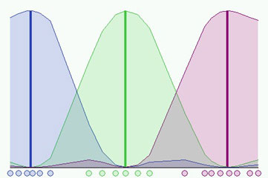
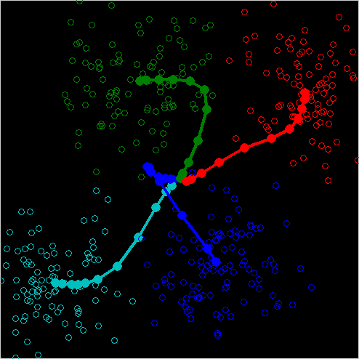
Fuzzy Clustering Algorithms

Slide 2
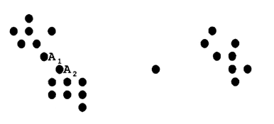
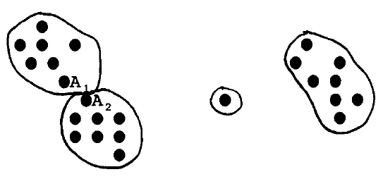
What is Clustering?

Slide 3
Crisp & Fuzzy Clustering
CRISP | Each point belongs to exactly one cluster. C-Means Clustering
FUZZY | Cluster membership is a matter of degree. Fuzzy C-Means Clustering (FCM)

Slide 4
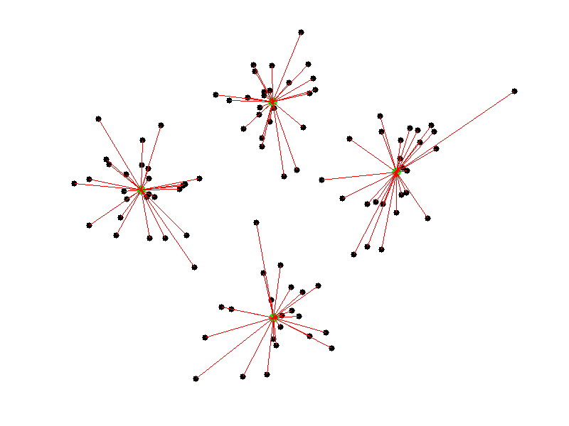
C-Means Clustering
Fixed number of clusters. One centroid per cluster.
Each data point belongs to the cluster corresponding to the closest centroid.

Slide 5
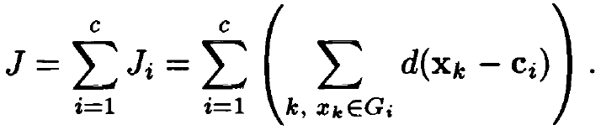
C-Means Clustering
distance between data point and cluster center
# of clusters
cost function
cost of the
i^{th} cluster
data points belonging
to the i^{th} group

Slide 6
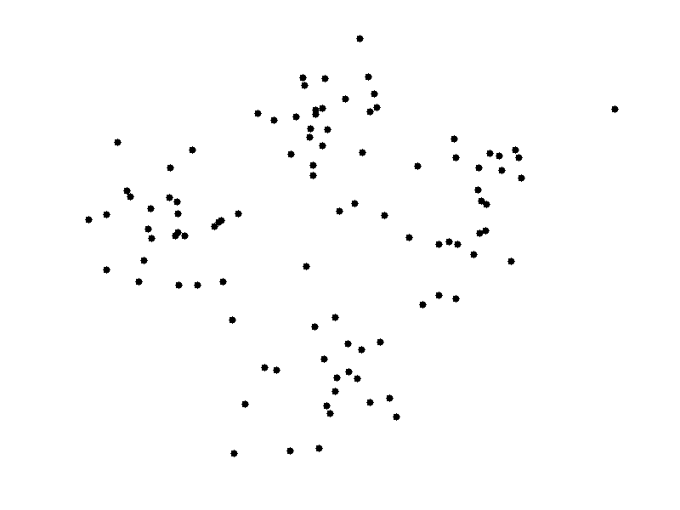

C-Means Clustering
pick c centroids at random
assign each data point to the cluster corresponding to the nearest centroid.
move each centroid to the mean value of its cluster’s data points.

Slide 7
Fuzzy C-Means Clustering (FCM)
Fuzzy C-Means Clustering
Fixed number of clusters.
One centroid per cluster.
Clusters are fuzzy sets.
Membership degree of a point can be any number between 0 and 1.
Sum of all degrees for a point must add up to 1.

Slide 8

Fuzzy C-Means Clustering (FCM)
Fuzzy C-Means Clustering
C-Means
Fuzzy C-Means (FCM)
summing over all data points
fuzziness
exponent
membership
degree

Slide 9
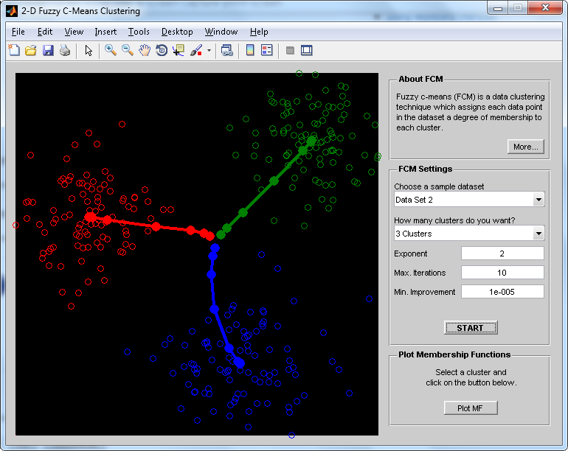
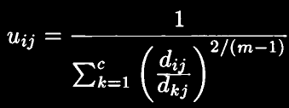

Fuzzy C-Means Clustering
pick c centroids at random
assign membership degrees according to:
move each centroid to the following position:
Note: formulas are result of the method of
Lagrange multipliers as applied to aforementioned
cost function

Slide 10

Crisp & Fuzzy Clustering
CRISP | Each point belongs to exactly one cluster. C-Means Clustering
FUZZY | Cluster membership is a matter of degree. Fuzzy C-Means Clustering (FCM)

